Slide 1
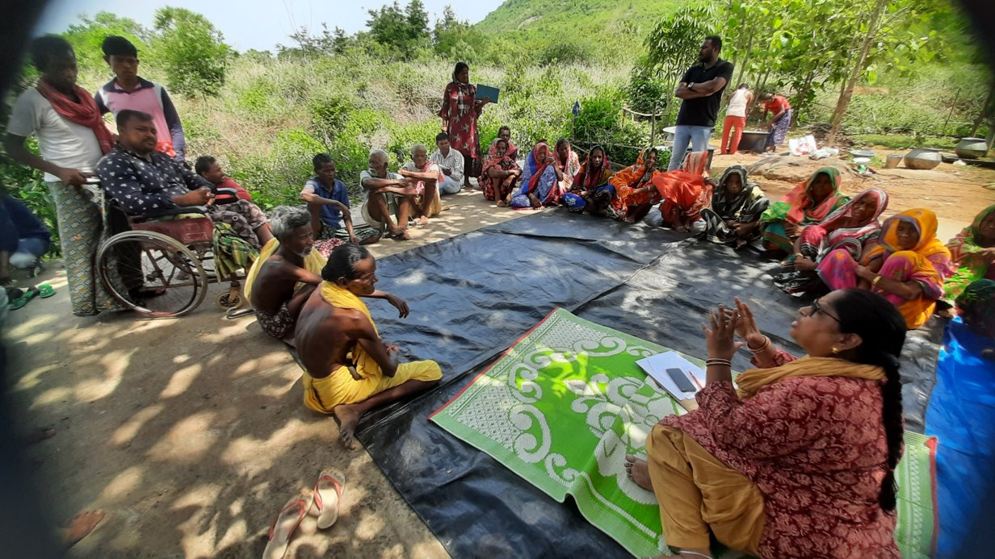
The Displaced

Slide 2
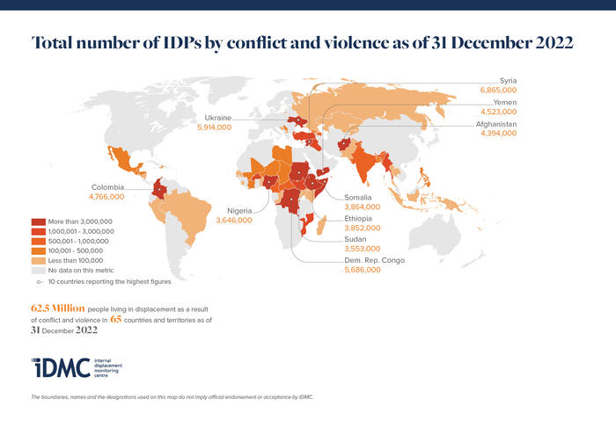
CONTEXT
India, like several other countries, is confronting the issue of Internal Displacement. Conflict-induced displacement is common in States like Kashmir, Andhra Pradesh, Gujarat, Orissa, Chhattisgarh and the 5 North-East.
The Internal Displacement Monitoring Cell (IDMC) , of the Norwegian Refugee Council, estimated that, as on December 31, 2112, there were “at least 540,000 people displaced by armed conflict and violence in India”.
The following data has been drawn from the IDMC

Slide 3
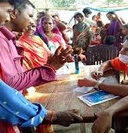
IDPS in India
250,000 Kashmiri Pandits displaced from the Kashmir Valley since 1990.
Violence and conflict in north-east India, in which at least 115,000 people have been displaced. The details include: 36,000 Muslims internally displaced in Assam by intercommunal violence in July and August 2012 staying in official camps, with potentially hundreds of thousands remaining in displacement outside of official camps; more than 46,000 Adivasis, Bodos and Muslims displaced by inter-ethnic violence in Western Assam in the 1990s
Naxalite conflict in Central India, Naxalite conflict in Central India, leading to at least 148,000 people. This includes: 40,000 Adivasis living in displacement at the end of 2009, of whom half were staying in camps in Chhattisgarh and half were scattered across Andhra Pradesh; 8,000 Adivasis living in displacement in West Bengal; more than 100,000 people displaced from Chhattisgarh since June 2009; and
Communal violence in Gujarat and Orissa States, leading to 26,000 people remaining displaced, including: 16,087 people who still remain displaced as a result of the 2002 Hindu- Muslim violence in Gujarat State, all of whom are living in 86 relief colonies in Gujarat State; and at least 10,000 people displaced in 2007 and 2008 by Hindu-Christian violence in Orissa

Slide 4
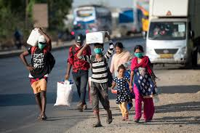
Causes of Displacement in India
Armed Conflict
Violence
Violation of human rights
Disasters
Other factors: Other causes of internal displacement can be large scale development projects (dams, mining centres, SEZs etc.) built without making an attempt to compensate, rehabilitate and resettle the displaced population by the Government

Slide 5
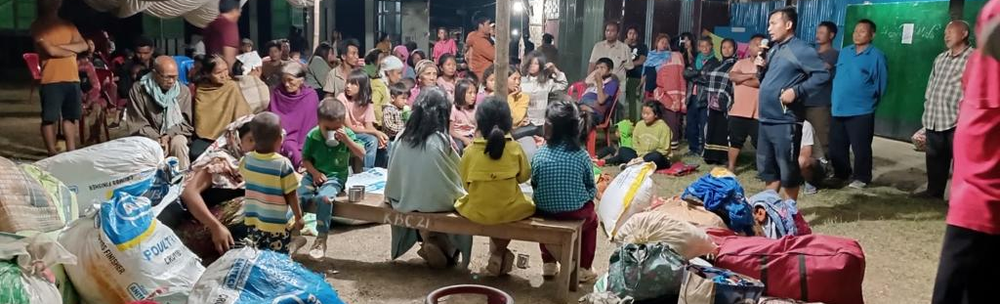
Conflict in Manipur state
On 3 May 2023, the Kuki tribal group held an organised protest march in the northeastern Indian state of Manipur against the majority Meitei community being recognised as a Scheduled Tribe. The march resulted in violent clashes with the Meitei non-tribal group (Reuters 11/05/2023; Al Jazeera 07/05/2023 and 06/05/2023).

Slide 6
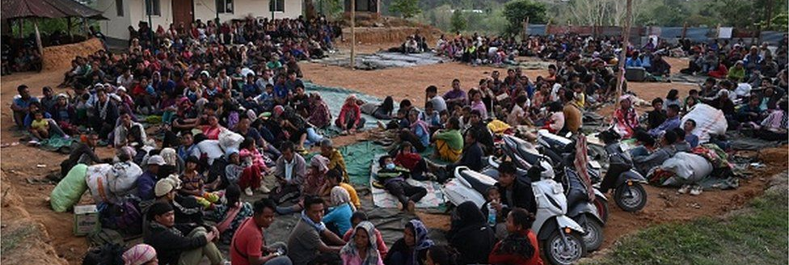
The Digress
As on 12 May, reports indicated that 45,000 people were displaced or had evacuated their homes in violence-affected districts, and government premises, army camps, and nearby states were sheltering most of these people.
The number of displaced people varies between sources, with some media sources reporting 30,000–35,000 people displaced as on 16 May
Image – Courtesy - BBC

Slide 7
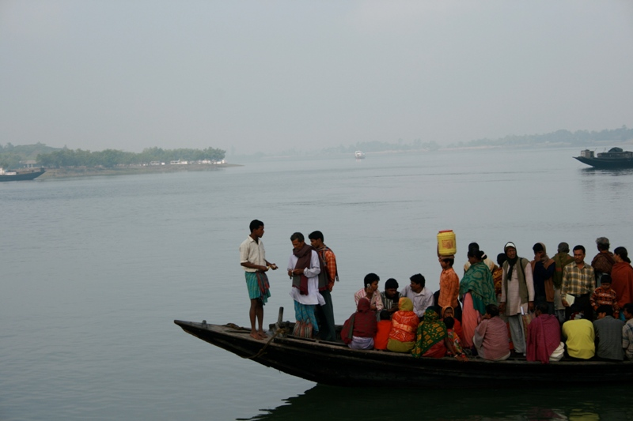
Sundarbans – Climate Change induced Migration and Modern Slavery ( CCMMS)

Slide 8
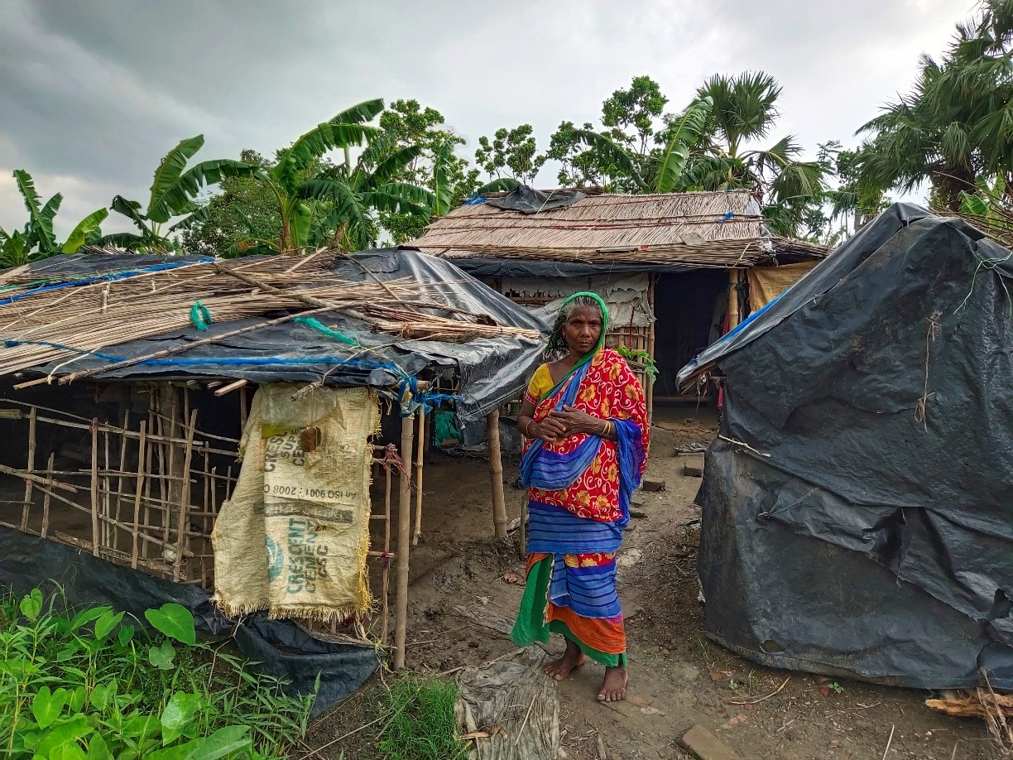
Focus Communities
……..aims towards building livelihood resilience of communities by integrating ecosystem restoration, climate change adaptation hence reducing distressed/unsafe migration leading to modern slavery.
Disaster Risk Reduction Committee
Task Force members on different issues
local authorities
rescued persons/ survivors
Marginal Farmers
community leaders
Border Forces, NGOs, Police, Concerned Govt departments

Slide 9
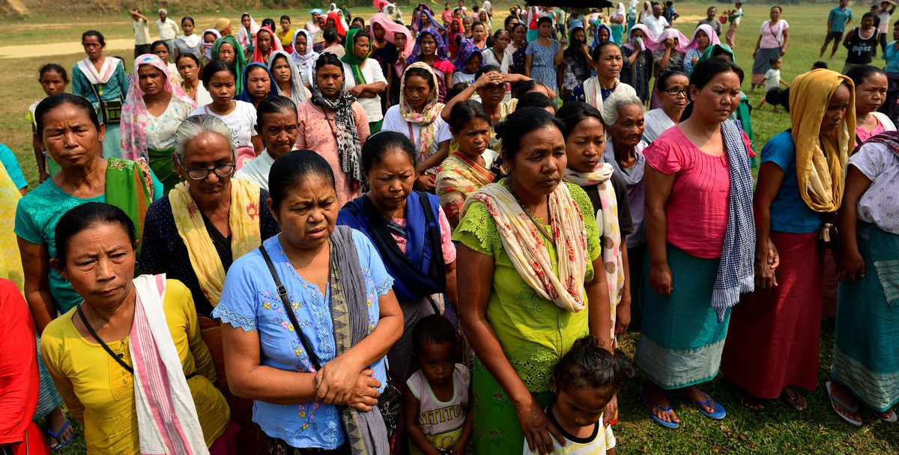
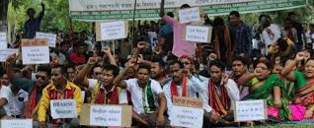
Restoration and Peaceful Return of People from camps to their homes and Peaceful Co-Existence – Ethnic Conflict Rabha and Garo community in Assam and Meghalaya

Slide 10
Our Response
18000 people were provided with relief materials consisting of nearly ten tons of rice, potatoes, dal, salt dried fish, vegetables and chilies while in displacement .
1028 families returned to their own homes/original place as a result of intense involvement and effort in bringing back peace and normalcy.
Within 1 to 2 month both the communities were shifted to temporary camps near the villages and within 3 to 4 months all the people went back to their original homestead. This happened due to the confidence building initiated by the proejct in collaboration with local Church bodies and government.
22 village level Peace & Rehabilitation Committees were formed. This process helped in coordination with different organization and bodies and in quick rehabilitation.
In order to bring about lasting peace and to propagate the concept of peace among the village community a youth Peace Club has been formed with members from both the affected communities . The team has been performing Peace Promotion Programmes in the villages as well as they are being called to give programmes at different public functions.

Slide 11
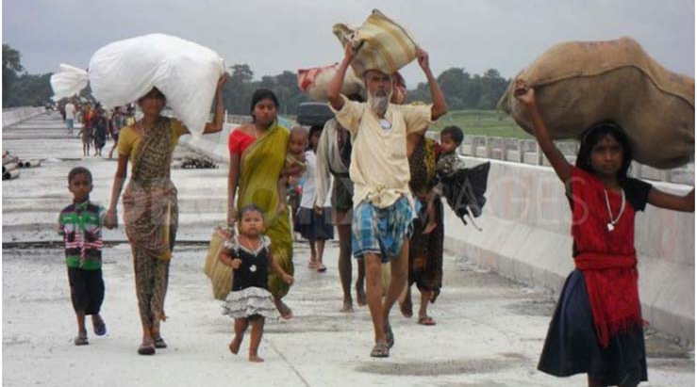
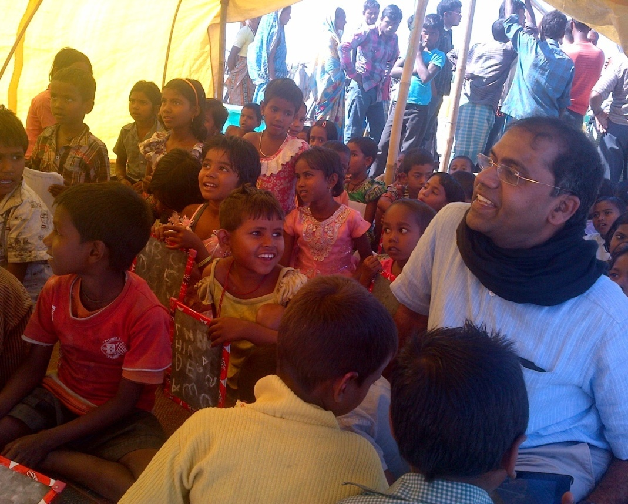
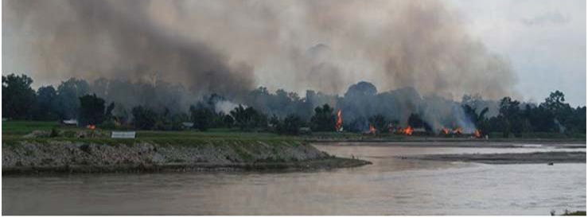
Ethnic Violence in West Assam – Boro and Muslim

Slide 12
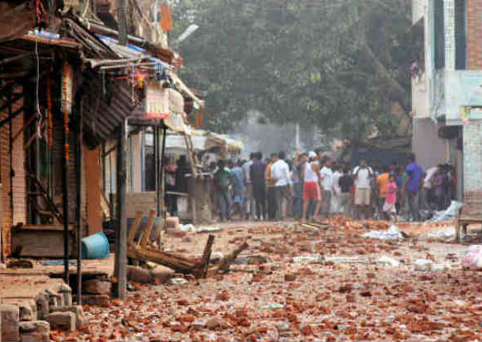
Communal Riot in Muzaffarnagar

Slide 13
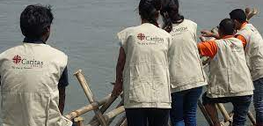
Key Sectors of Immediate Intervention
Protection
Shelter and Non food items
Conditional and unconditional cash
Water, Sanitation and Hygiene
Food Security and Livelihood

Slide 14
Interim Support and Aid
Protection services
a) Medical Care, b) MHPSS (Mental Health and Psychosocial Support) c) Setting up of safe spaces for children and mothers
Protection of most vulnerable through Food assistance:
Food kit including nutrition kit will be provided to meet ration shortage/fill the gap of inability to purchase the food.
Provide Safety net through Non-Food Items (NFI) and Dignity Kits for women:
NFI containing mattresses, bedsheet, cooking utensils, buckets, water jerrycans, etc. will be provided to meet daily life needs.
Protection through WASH services: The response also will cover the water trucking ( only where ever need) , repair and recovery of the piped water network/system, access to safe water
Temporary Shelter support:
for the prolonged stay in camps and temporary settlements through conditional cash transfer.

Slide 15
Long term Aid and preparedness
Back home kits for returnees:
Conditional cash transfer confining to rebuilding and rehabilitating the damaged houses or assisting the crisis affected people by providing shelter materials.
Promotion of Social cohesion (Peace building efforts):
Arbitration and negotiation to facilitate return/settlement of camp inmates safely to their desired locations with support from local stakeholders and government authorities, provisions for children and adults/youths counselling affected by clashes, re-admission to schools.
Strengthening coordination:
Civil society coordination through Interagency group and Civil society interaction , Government collaboration, capacity building of local actors .

Slide 16
European Return and Reintegration Network (ERRIN II)
2018-Present

Slide 17
2022
REINTEGRATION PROGRAMME JOURNEY
Closure of ERRIN and
a new journey Begins with FRONTEX
2022
2018
ERIN –II.
Danish Council for Refugee Netherlands.
ERIN –I initiated in 2017.
2017
2017
Networked with different agencies for reintegration programme :Micado Migration Germany, Verenigin Vluchtelingenwerk Netherland, Caritas Austria
2013
Caritas joined hand with Refugee Action UK for CHOICES programme
2011
Caritas India began its journey on reintegration programme with Caritas International Belgium
2010

Slide 18
PROCEDURES: PRE-RETURN
Returnee
Pre-departure counseling services
EPI (BAMF, UKHO, OFII, BMI + FEDASIL, DMII, R&DS)
CIB
Local SP-CARITAS INDIA
Leaflet at Asylum Centre, through friends, NGOs &CSO
Registration form, application form
National annex, reg form, eligibility confirmation
Fwd all docs and information

Slide 19
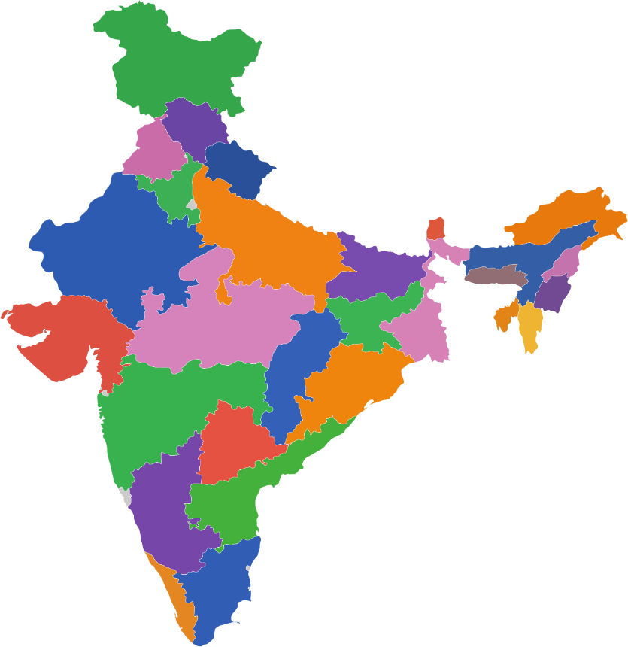
ERRIN NETWORK IN INDIA
High Migration States are Gujarat, Punjab & Haryana
Other states includes Telangana & Andhra
Pradesh, Tamil Nadu, Kerala, Karnataka,
West Bengal, Maharashtra and Delhi.
A total of 627 returnees reintegrated within 4 years from the European Countries
North (5 Partners)
West (5 Partners)
Central India (1 Partner)
East India (1 Partner)
South (19 Partners)
: Geographical Presence
: Field Partners
Map of India showing number of Caritas India Field Partners for Reintegration Programme (31 partners for ERRIN Programme)

Slide 20
LOCAL PARTNERS
ACTIVE PARTNERS
Navjeevan Charitable Society- Jalandhar, Punjab
Manav Vikas Samiti
Chandigarh
Chetanalaya
Delhi, Haryana, Jammu & Kashmir
Sabarmati Samruddhi Seva Sangh
Gandhinagar, Gujarat
Kaira Social Service Society-
Ahmedabad, Gujarat
Krishnagar Cathedral Charitable Society-
West Bengal
Lodi Multipurpose Social Service Society-
Telangana
Hyderabad Archdiocese Social Service Society-
Hyderabad
Madras Social Service Society-
Madras, Tamil Nadu
Thanjavur Social Service Society,
Thanjavur Tamil Nadu
Welfare Social Service-
Ernakulam, Kerala
Trichirappalli Multipurpose Social Service Society-
Trichy, Tamil Nadu

Slide 21
REINTEGRATION ASSISTANCE
Type of support provided to the returnees
Pre-Departure service
Meet & Greet service. Also, ambulance arrangement for medical cases.
Business Consultancy support
Basic Counselling
Legal advice
Vocational training for beautician
Accompaniment support to hospital and school
Monitoring visit returnee house and business site

Slide 22
WORKFLOW-POST RETURN
Pre departure Counselling
Meet & Greet
Services
Interaction with the Returnee on Arrival
ERRIN reintegration Confirmation from returnees
Introduction about Organization (Caritas India)
Briefing on Reintegration Assistance
Caritas India’s role in assisting returnees
Airport Assistance
Temporary Accommodation
Travel Arrangement to destined location.
Ambulance services on severe Medical situations
Introduction about Organization
Briefing on Reintegration Assistance
Information from returnees on utilization on package
Reintegration need verification visits to returnees
Close Accompaniment to Returnees
Close Accompaniment to Field Partners:
Recommendation by field partners for payment processing.
Reintegration Plan making(Micro Business Planning).
Assistance in developing required documents(legal and non-legal) according to reintegration activity being chosen by returnees
Monitoring visits to returnees.
Peer group discussion.
Two Capacity Building Training in a year for all Programme Coordinators.
Monitoring visits to local partners
Processing of Payment for Returnees
Proof of payment done
Processing of Accompaniment Cost
4-5 working days for Cheque making.
Bank transfer in urgent situations
Cheque Receipts
Supplier Receipts
Bills/ Invoice copies
In case of Taxi/ Autorickshaw/Tractor Business: Vehicle Registration Copy on the Returnees’ name.
Financial Report
Cover Sheet
Bank Statement
Specification of expenditure (copy invoice)- bill/quotation
Proof Of Payment of expenditure: Cheque
Cheque Receipt
Bank Statement

Slide 23
Returnee Composition
Gender
Composition

Slide 24
REINTEGRATION SUPPORT

Slide 25
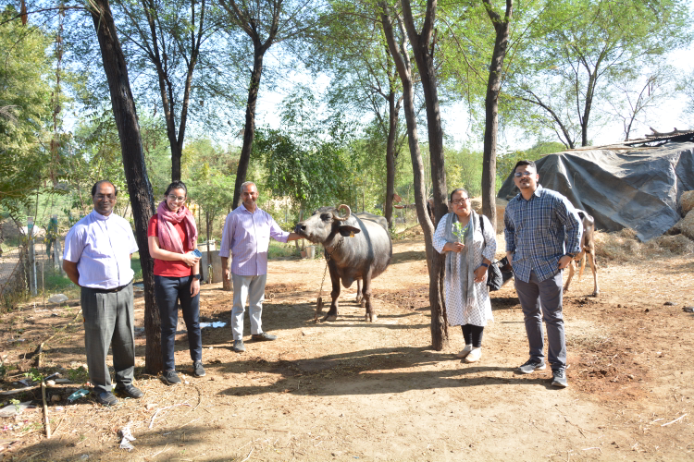
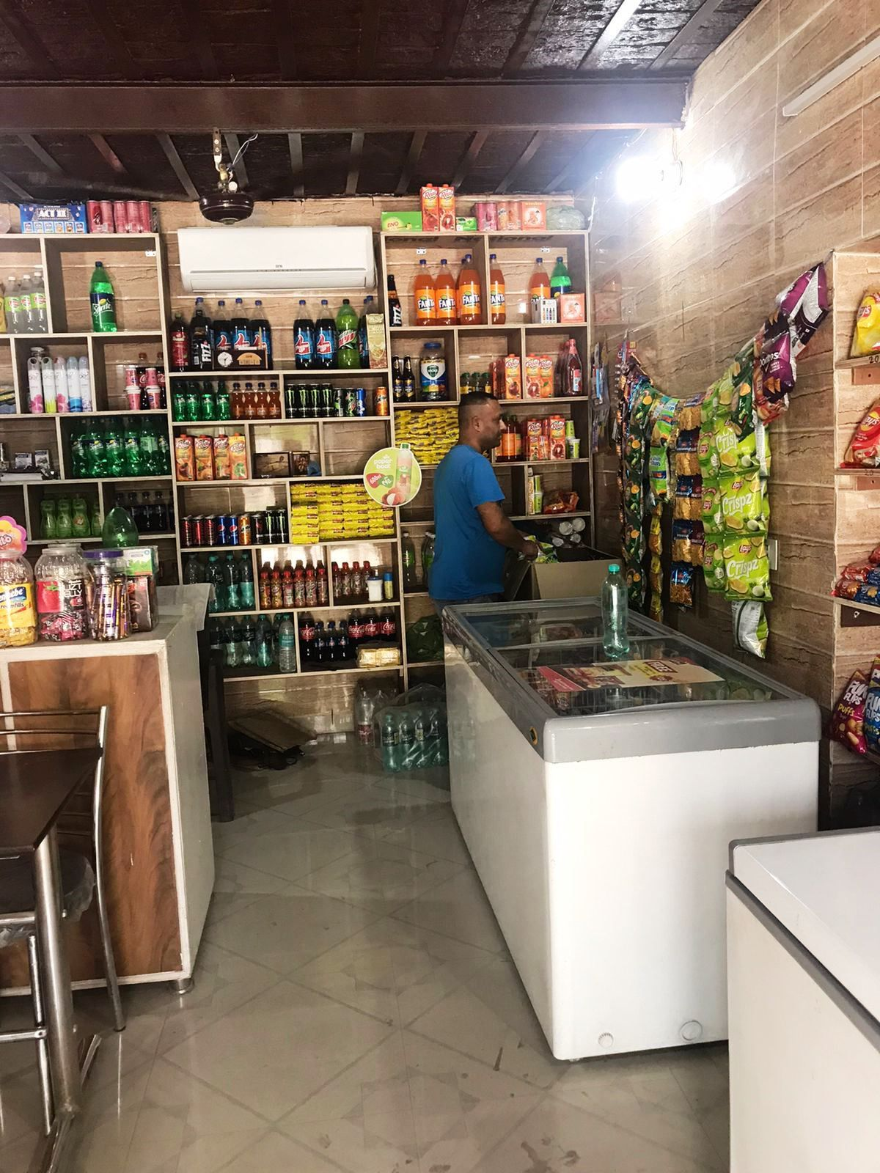
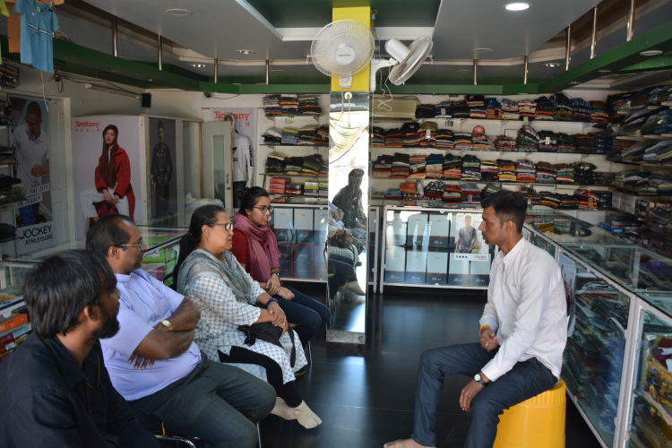
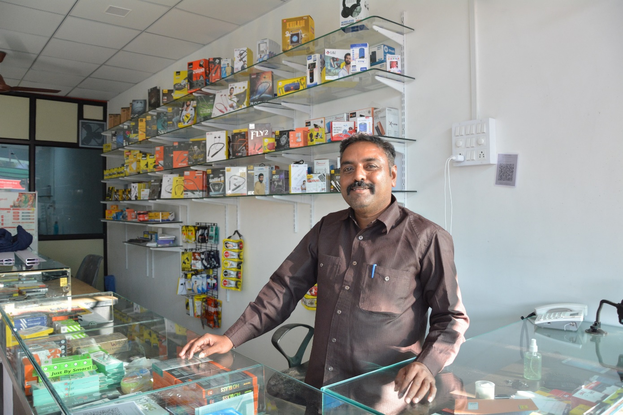
REINTEGRATION SUPPORT

Slide 26
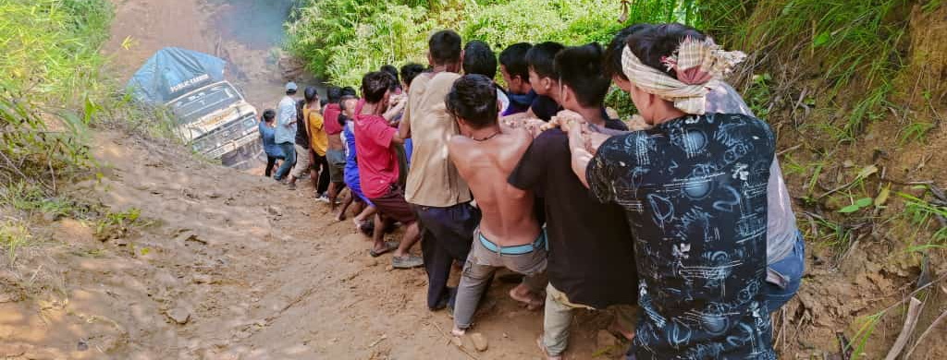
-PROCAP-
Protecting rights of the crisis-affected population in the Northeast states of Mizoram and Manipur
March 2022-March2023
Funding amount: 600,000 Euros
Donor-ECHO

Slide 27
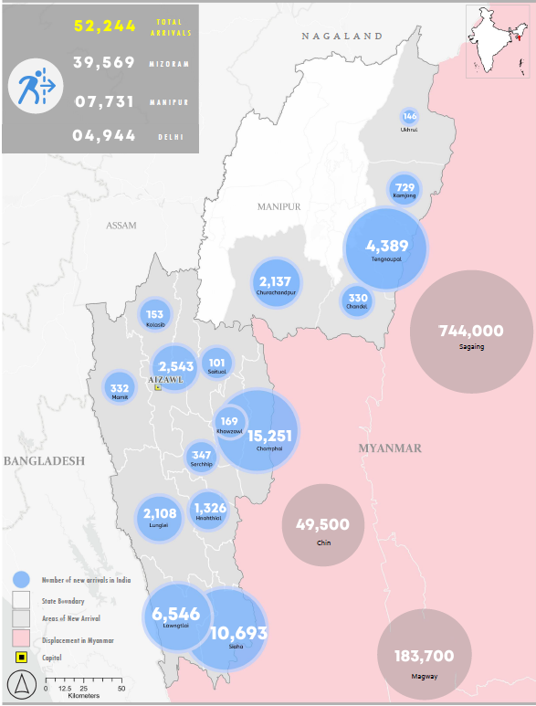
As on 24 March 2023, estimated new arrivals in India:
52,250
Mizoram: 39,550*
Manipur: 7,750*
Delhi: 4,944
The projections for 2023 are
80,000
*estimates by Govt. of Mizoram and community-based organization in Manipur and Mizoram

Slide 28
Security and Operational Context
Security situation in Myanmar, (Chin State and Sagaing Region – bordering India), continues to deteriorate - Increased movement of new arrivals into Manipur and Mizoram.
Perception of Government - Tacit approval of the central government. State governments are more supportive.
Security concerns in India - Strengthened border controls by government, new arrivals frequently accused of trans-national organised crimes (smuggling, trafficking in contraband) and the area is sensitive.
Humanitarian and protection space in Northeast continues to be delicate - Measured low visibility and low-profile response.
Operational context of Manipur - arrests and detentions, verification drive to identify ‘illegal immigrants’, temporary accommodation to be set up for Myanmar arrivals.
Challenging geographical terrain – difficulty in provision of humanitarian assistance.
Coordination through Informal Working Group (Refugee coordination mechanism) and close cooperation and participation by UN, NGOs and CBOs.
Notes:
Geographical terrian

Slide 29
Key Findings

Slide 30
Protection
Preferred Referral Services
Community Leaders / Organisations
NGOs/ Women centres
Family / Relative
Gaps
Lack of protection services / staff
Lack of awareness about available protection services
Language barriers
Notes:
Top child protection needs – healthcare, education, food
Women reported feeling an increased vulnerability to violence and sexual harassment
Coordination b/w CBOs, AR, Police, security forces in Mizoram
VLCMR – Village level committee for Myanmar Refugees (active in Champhai, not other parts of Mizoram. Part of State level committee. There should be three level of committees – state, district, village)

Slide 31
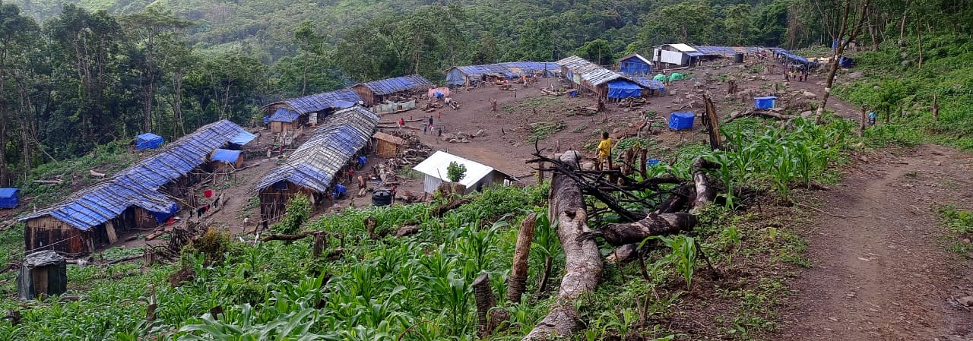
Principal objective:
Forcibly displaced populations (FDPs) and most vulnerable host communities live safe and dignified lives.
Specific objective:
Forcibly displaced populations meet their immediate needs with access to inclusive, multi-sectoral assistance with a focus on protection mainstreaming.
Mizoram and Manipur
9 Districts | 13 Blocks, 10 Camps |28 Villages (R-51)
Targeted Reach:
3600 HHs |18720 FDPs

Slide 32
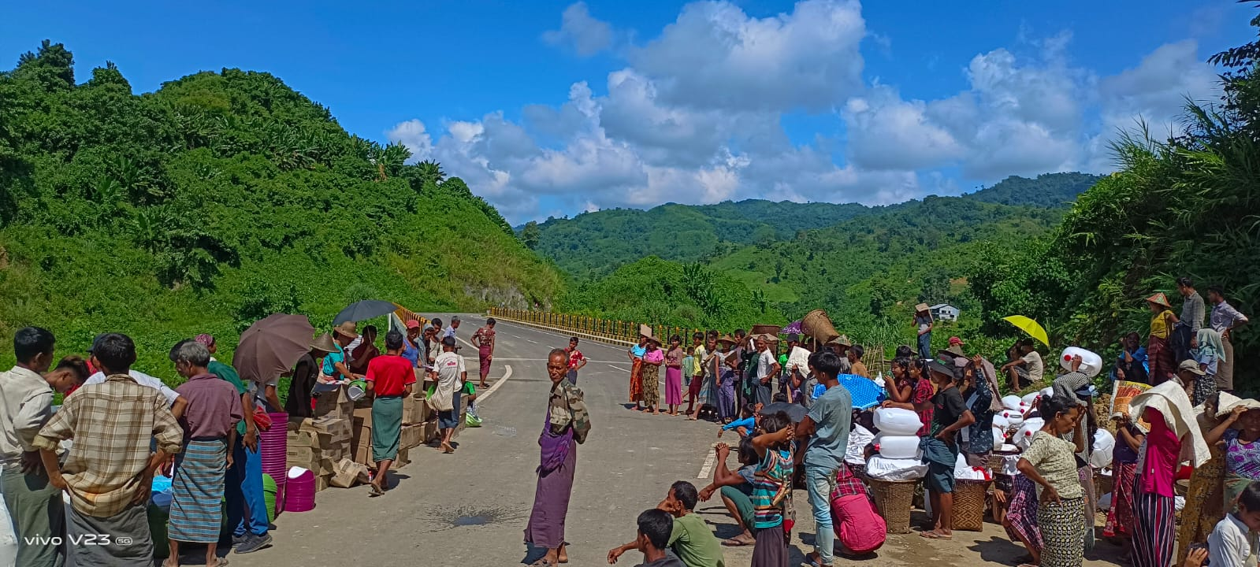
Key Strategies
Engagement and participation of the project stakeholders including the project participants at every stage of the implementation cycle.
Formation of the community-based committees for consistent monitoring, feedback and learning.
Application of scientific method complemented by community consultation to identify the most vulnerable families within the respective response sector.
Anchoring and strengthening protection mainstreaming actions as cross cutting thrust.

Slide 33
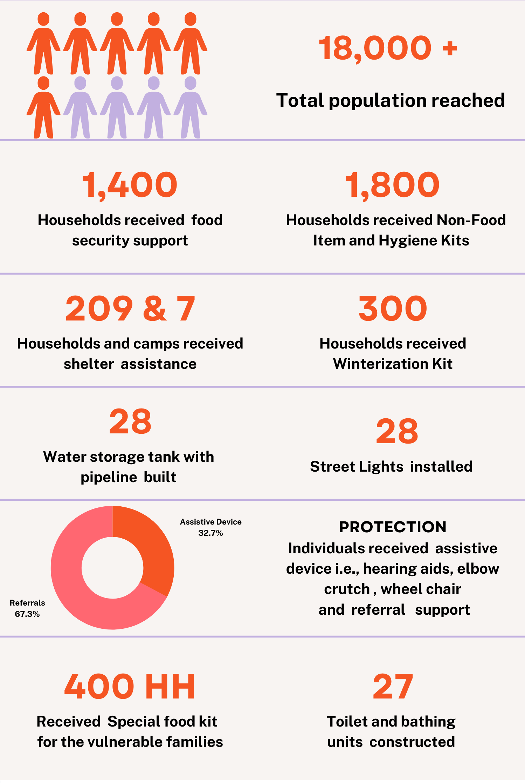
Programme Support – PROCAP (Mizoram & Manipur)
ELDERLY
FOOD
SECURITY
PREGNANT AND LACTATING MOTHER
AFFECTED
POPULATION
WATER, SANITATION
AND HYGIENE
CHILDREN
HOST COMMUNITY
SHELTER
PEOPLE WITH PHYSICAL IMPAIRMENTS
PROTECTION
MEN & WOMEN

Slide 34
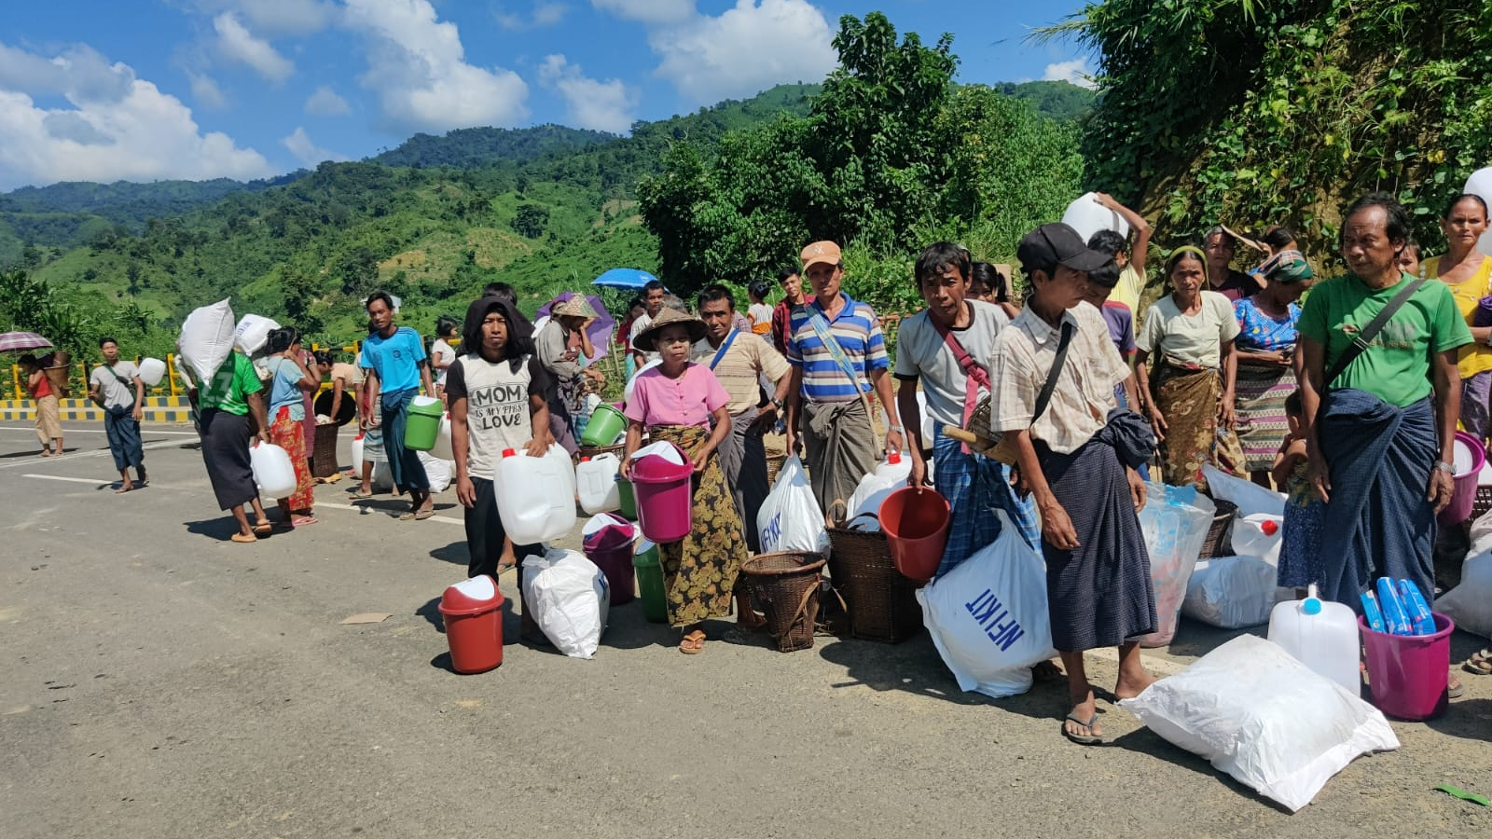
Key Highlights:
Staff Capacity building initiatives
Reaching to the most vulnerable HHs
Stretching beyond capacities
Adapt the process modalities
Regular update to donor on the changes/situation
Inter agency coordination and Information channelization
Modification to factor in changes
Bridging the fund gap - currency exchange loss

Slide 35
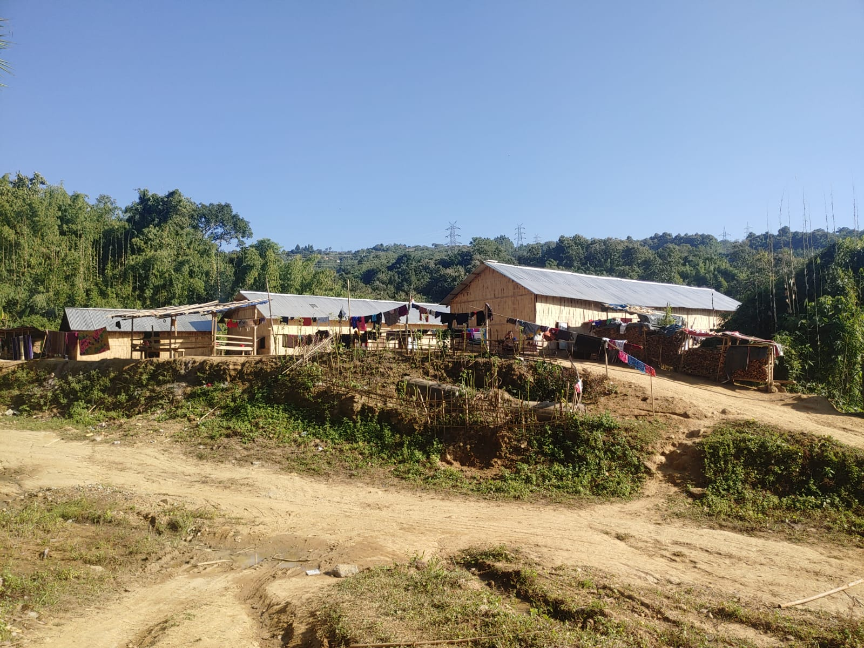
Challenges- Learning
Vast geography – difficult terrain
New themes and issues– less experiences |skills
Rainfall and landslides
Level of understanding / new staff
Stringent security situation
Location changed/increase numbers
Strong coordination /Information flow
Consistent inflow /relocation & shifting
Resource mobilisation and complementarity
Skill building -imperative

Slide 36
Key Priorities
Scale up food assistance
Cash or voucher support
FOOD
Cash / voucher support for Shelter / NFI
SHELTER
HEALTH
Advocacy and linkages with government health systems
Extend services to remote locations
Integrate MHPSS in partner programs

Slide 37
Recommendations
Sectoral Engagements
Protection
WASH
Education
Livelihood
Well lit community areas
Increase access to drinking water
Additional language classes
Promote livelihood activities that contribute towards peaceful coexistence
Special care for UASC
Increase number of community toilets
Provision of education material
Awareness building - GBV, CP & referral services
Separate WASH spaces for men and women in settlement like areas
Assistance for children with specific needs
Linkages with Child Protection Committees

Slide 38
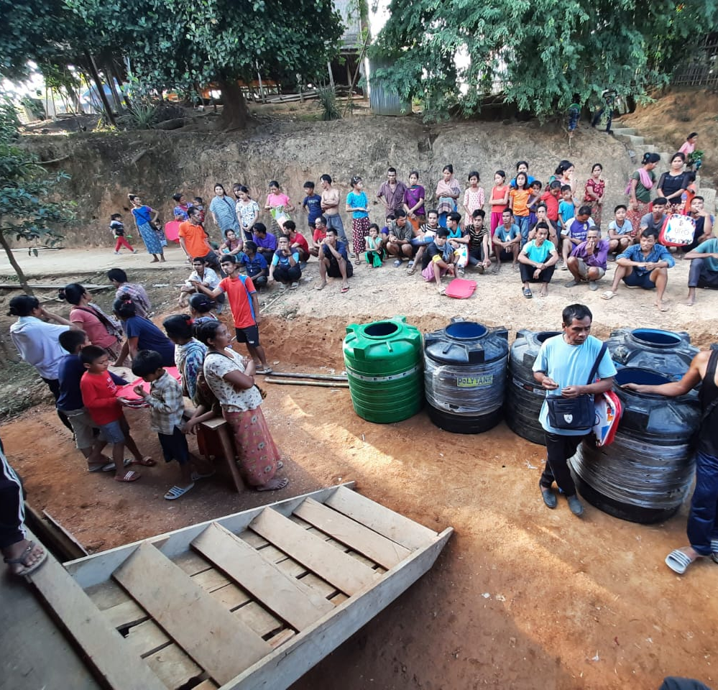
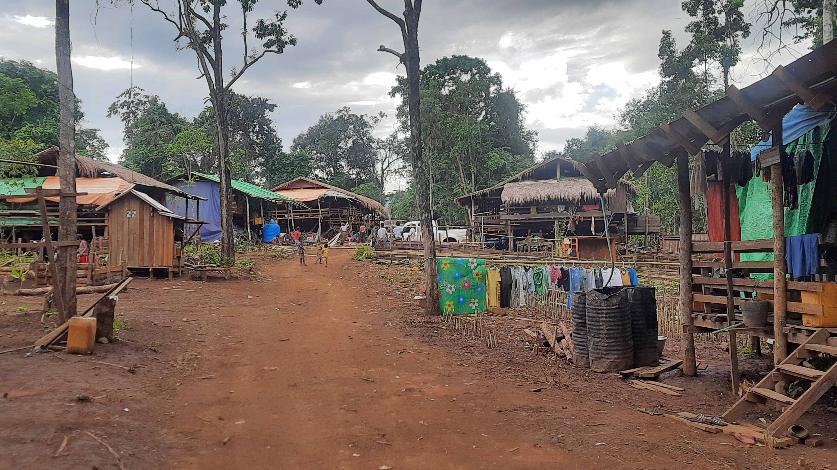

Slide 39
